Slide 1
Project 1: Interim Presentation Treatment Responses to HAART in Multicenter AIDS Cohort Study
Rachel Johnson
BIOS 6623

Slide 2
Data Summary
Research question:
How do treatment responses after 2 years differ between subjects who report using hard drugs and those who didn’t?
Primary predictor
Hard drug use at baseline (Yes (n = 467) vs. No (n = 39))
Covariates selected by investigator
Baseline: outcome value, age, BMI, alcohol use (13 or fewer vs. >13 drinks), smoking status (never/former vs. current), income level (<$10,000, $10,000-$40,000, >$40,000), education (HS or less, >HS)
2 year: ART adherence (>95% vs. <95%)

Slide 3
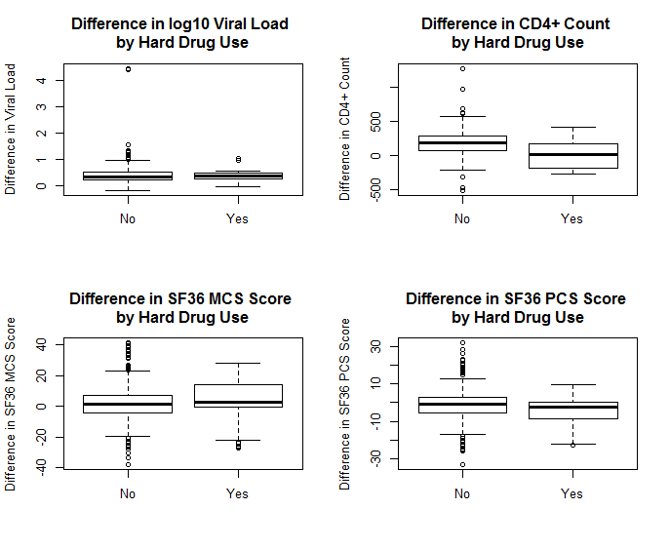
Outcomes

Slide 4
Bayesian framework analysis
Linear regression for each outcome (difference from baseline to 2 year mark)
PROC MCMC, random walk Metropolis-Hastings algorithm, starting values of 0 for parameters and 1 for variance
Vague/uninformative priors
Parameters (3 of 4 models): ~normal(mean = 0, variance = 1000)
Error: ~inverse gamma(shape = 2.001, scale = 1.001)
Parameters (CD4 outcome): ~normal(mean = 0, variance = 10000)
DIC used to compare full model and model with one covariate removed at a time
Model was tested without alcohol consumption, smoking status, marijuana use, and education or income
Final model removed all covariates that improved DIC when removed

Slide 5
Quality of Life Difference Outcome | Hard drug posterior mean | Hard drug 95% HPD interval
SF-36 MCS (Mental)* | -0.2167 | -3.4630, 3.33566
SF-36 PCS (Physical)* | -3.6128 | -5.9669, -0.8246
*Adjusted for baseline, age, BMI, ART adherence at 2 year mark, race, income
Hard drug not a strong predictor of difference in SF-36 MCS
Hard drug much stronger predictor of difference in SF-36 PCS

Slide 6
Laboratory Difference Outcome | Hard drug posterior mean | Hard drug 95% HPD interval
Log10 Viral Load* | -0.0363 | -0.1595, 0.1015
CD4+ Count* | -157.4 | -216.4, -100.0
*Adjusted for baseline, age, BMI, ART adherence at 2 year mark, race, income
Hard drug not a strong predictor of difference in log₁₀ viral load
Hard drug much stronger predictor of difference in CD4+ count

Slide 7
Conclusion & Limitations

